Slide 1


Introduction to Competitive Programming
Week 4: Range Queries
Notes:
https://join.slack.com/t/introductiont-c5a2137/shared_invite/zt-djtdwpqu-S_tju9SZhk2IKhcYICitCQ

Slide 2
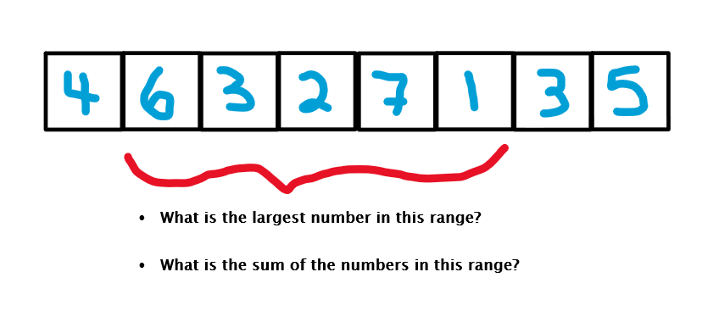
What is a range query?
A query (question) about a range of data
Stock prices, computational biology

Slide 3
1.
Prefix Sums

Slide 4
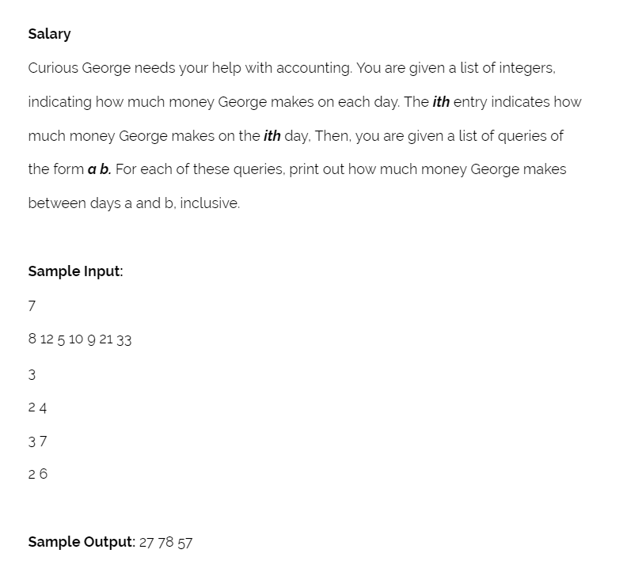
Motivation

Slide 5
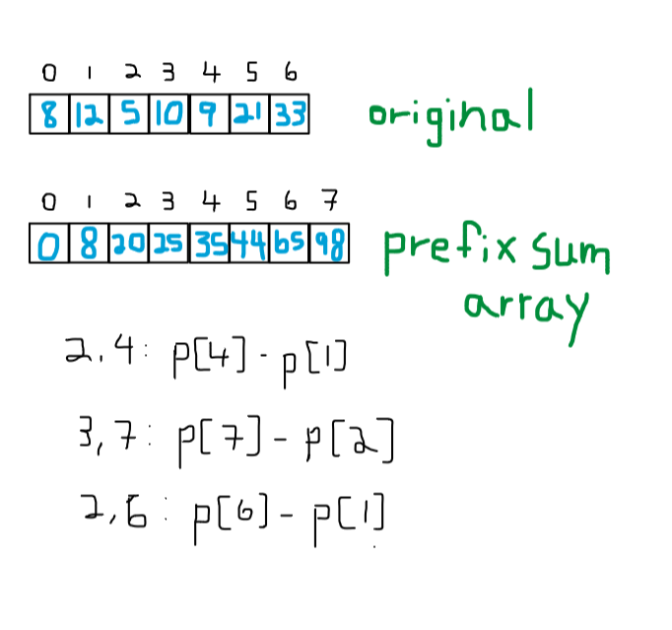
Prefix Sums

Slide 6
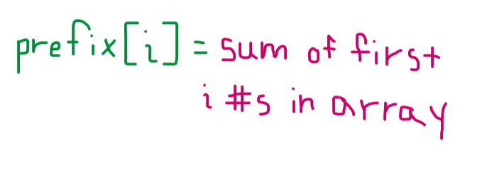
Prefix Sums

Slide 7
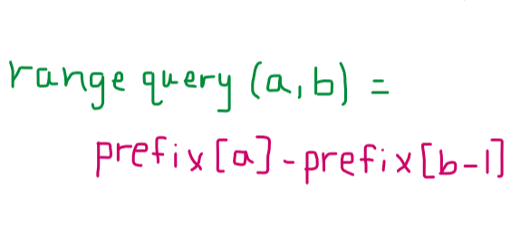
Prefix Sums

Slide 8
Prefix Sums
Jupyter Demo!

Slide 9
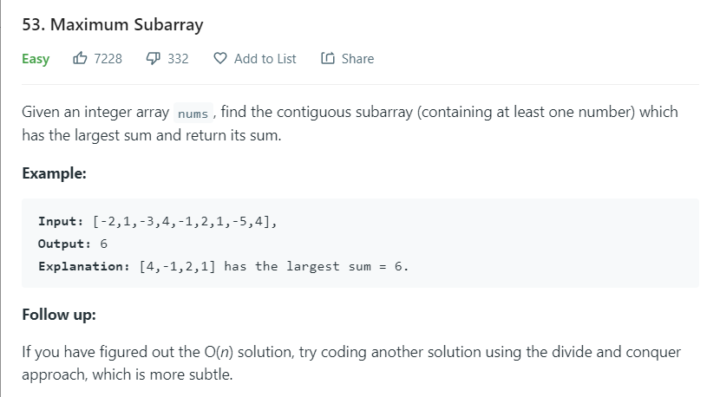
Seem familiar?

Slide 10
2.
Sliding Window

Slide 11
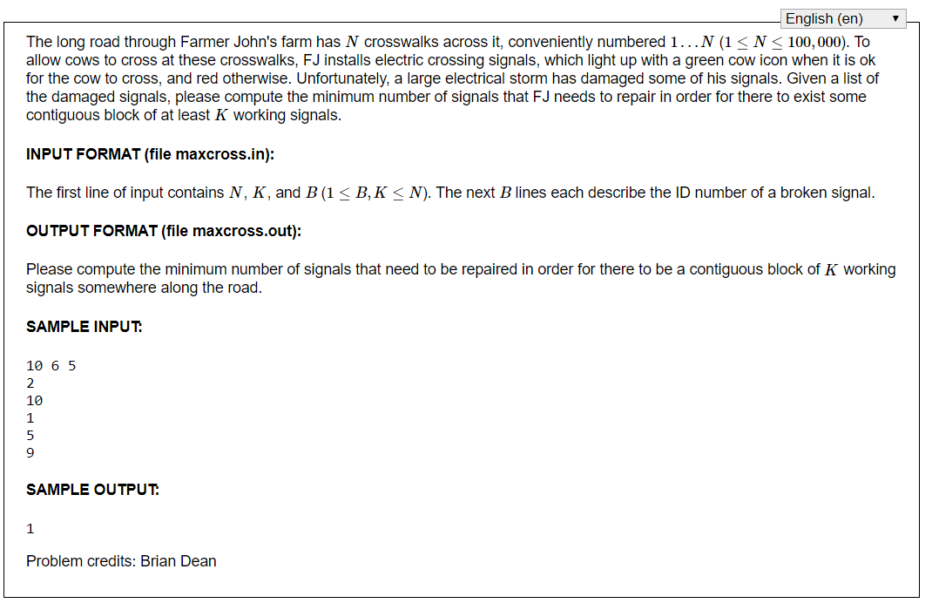
Motivation (and a look at USACO Silver)

Slide 12
Motivation (and a look at USACO Silver)
Jupyter Demo!

Slide 13
Generalized Sliding Window
Data in list-form
Answer queries about ranges
  Left and right pointers non-decreasing
Do not recompute elements that are shared between two ranges

Slide 14
3.
Two Pointers

Slide 15
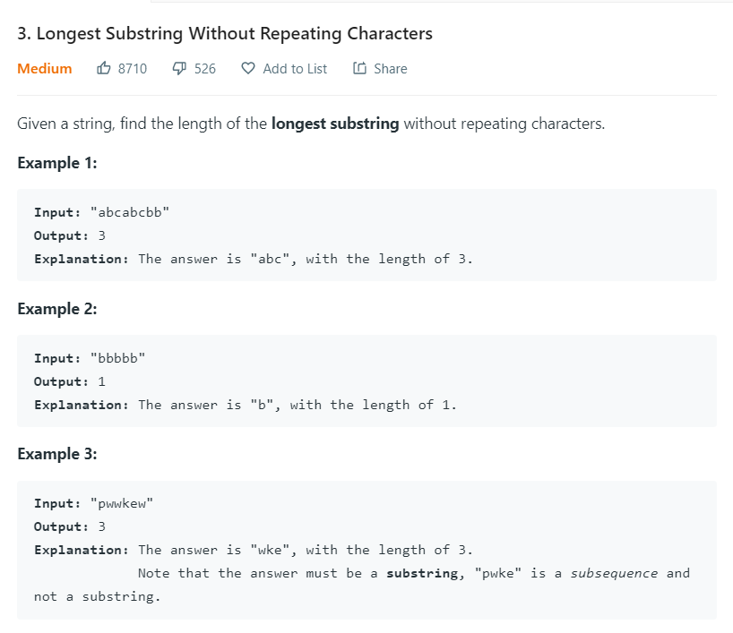
Motivation

Slide 16
Two Pointers for Range Queries
A range is uniquely determined by a left pointer and a right pointer
Rather than try every range (O(N²)), we prune our search
Left and right pointers only move to the right
  O(N)

Slide 17
4.
Endnotes

Slide 18
Homework
Week 4: Range Queries
  Prefix sums, sliding windows, two pointers
Highly encouraged
  4-5 / week
  Discussed on Slack
  Leetcode

Slide 19
5.
Live Coding

